Slide 1
CS 5910
Fundamentals of Computer/Network Security
Lesson 15 Server Certificate and Installation
Edward Chow, Ph.D.
University of Colorado, Colorado Springs
Notes:
In this lesson, we show how to create the server certificate, get it signed, and install signed server certificate with private key in the location specified by the web server configuration file. We use tools provided by AWS AMI instance and apache web server as an example.

Slide 2
Server Certificate Generation
[ec2-user@ip-172-30-0-148 server]$ mkdir server; cd server
[ec2-user@ip-172-30-0-148 server]$ /etc/pki/tls/misc/CA -newreq
Generating a 2048 bit RSA private key
…
writing new private key to 'newkey.pem'
Enter PEM pass phrase: <enter password>
Verifying - Enter PEM pass phrase: <confirm password>
-----
Country Name (2 letter code) [US]: enter
State or Province Name (full name) [Colorado]: enter
Locality Name (eg, city) [Colorado Springs]: enter
Organization Name (eg, company) [UCCS]: enter
Organizational Unit Name (eg, section) [CS]: enter
Common Name (eg, your name or your server's hostname) []: cs591.myuccs.com
Email Address []: webmaster@cs591.myuccs.com
…
A challenge password []: enter
An optional company name []: enter
Request is in newreq.pem, private key is in newkey.pem
[ec2-user@ip-172-30-0-148 server]$ cp newreq.pem server1req.pem
[ec2-user@ip-172-30-0-148 server]$ cp newkey.pem server1key.pem
Put in the server name or *.domainname to match more servers you will run as a web server. Critical !! Since the browser will try verify this common name value with that domain name of the IP address the server used.
Send newreq.pem out to CA for signing
Keep this in protected directory. Don’t sent this to CA!!
Rename them. Since every time CA –newreq is run the newreq.pem and newkey.pem are overwritten.
Notes:
Create a server directory; cd to the directory
Run /etc/pki/tls/misc/CA –newreq command to generate the private, public key pair. The script will ask for the subject name field.
Hit enter for default or enter your own site related info.
Common name should use the server domain name or the *. Followed by the domainname of the organization. It is critical to be exact here. Since the browser will match the common name presented by server in the certificate with the DNS reverse lookup of the IP address used by the server in https response. Use wildcard * followed by domain name allows the webmaster to use different server domainname without having to match it exactly. We only send the generated newreq.pem file which contains the certificate request for CA to sign. We should never send the newkey.pem which is private key to CA., even though it is encrypted with the passphrase.
Since the CA –newreq command will overwrite the newcert.pem and newkey.pem, It is wise to rename and save them as different filenames right after every time.

Slide 3
Sign Server Certificate
[ec2-user@ip-172-30-0-148 tls]$ sudo cp server1req.pem newreq.pem
[ec2-user@ip-172-30-0-148 tls]$ sudo misc/CA -sign
Using configuration from /etc/pki/tls/openssl.cnf
Enter pass phrase for /etc/pki/CA/private/cakey.pem: <enter passphrase>
Check that the request matches the signature
Signature ok
Certificate Details:
Serial Number: 16674478168221856406 (0xe767a58c7fdeb296)
Validity
Not Before: Mar 12 00:16:04 2017 GMT
Not After : Mar 12 00:16:04 2018 GMT
Subject:
countryName = US
stateOrProvinceName = Colorado
…
organizationalUnitName = CS
commonName = cs591.myuccs.com
emailAddress = webmaster@cs591.myuccs.com
…
Sign the certificate? [y/n]:y
1 out of 1 certificate requests certified, commit? [y/n]y
Write out database with 1 new entries
Data Base Updated [ec2-user@ip-172-30-0-148 tls]$ cp newcert.pem server1cert.pem
Notes:
We will use misc/CA –sign command to sign the certificate request. Since the command uses newreq.pem as input, we need to change the receive server certificate request file from server1req.pem to newreq.pem.
As a CA , we will be asked to enter the passphrase to decrypt the priate key in cakey.pem file. After confirming the signing, the signed certificate is saved in /etc/pki/tls/newcerts and a valid entry is created in /etc/pki/tls/index.txt database. Here we save the newcert.pem file as server1cert.pem in web repository /var/www/html for others to retrieve. We also return it to the requester in /home/ec2-user/server directory. In real life CA may return it via email.

Slide 4
Install Server Certificate and Private Key
Line 98 of /etc/httpd/conf.d/ssl.conf indicates the httpd web server look for
/etc/pki/tls/certs/localhost.crt as server certificate
Line 105 of /etc/httpd/conf.d/ssl.conf where is server key for https
[ec2-user@ip-172-30-0-148 tls]$ sudo cp server1cert.pem /etc/pki/tls/certs/localhost.crt
Since server1key.pem is protected passphrase, we need to remove that so that during the system reboot we do not have to enter it for web server to get the key.
[ec2-user@ip-172-30-0-148 tls]$ cd /home/ec2-user/server
[ec2-user@ip-172-30-0-148 server]$ sudo openssl rsa -in server1key.pem -out server1.key
Enter pass phrase for server1key.pem: <enter passphrase>
writing RSA key
[ec2-user@ip-172-30-0-148 server]$ sudo chmod 700 *.key
[ec2-user@ip-172-30-0-148 server]$ sudo cp server1.key /etc/pki/tls/private/localhost.key
cp: overwrite ‘/etc/pki/tls/private/localhost.key’? y
[ec2-user@ip-172-30-0-148 server]$ sudo service httpd restart
Notes:
The httpd configuration file for secure apache httpd server is saved in /etc/httpd/conf.d/ssl.conf. The lines 98 and 105 indicate the locations of the server certificate and server key where the web server will read in during the boot process. The private key file which is protected by passphrase needs to be unprotected. This is due to the fact that the server may be rebooted during midnight after server patches are applied. We do not want to be awaken up to enter the passphrase. Therefore we use openssl rsa command here to save the private key in plain text. We then save it to the localhost.key location here. We protect the privatekey by changing the file access right to 700 so that only the root can access.
We then use service httpd restart to let httpd reads in the new certificate and privatekey.

Slide 5
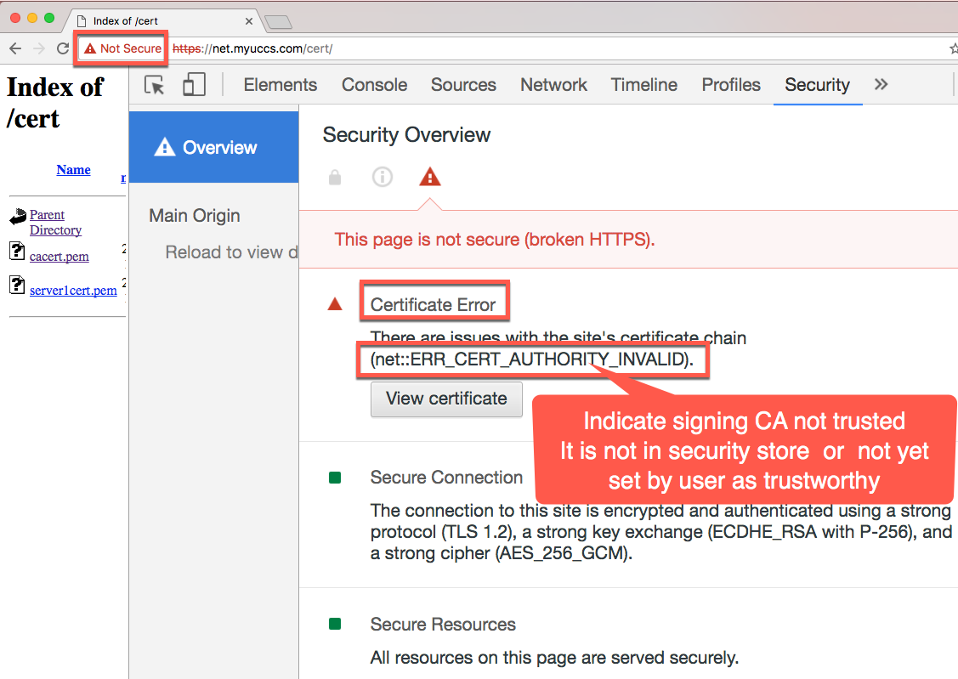
Verify the Server Certificate Presented
Here shows security overview of the Chrome browser after we enter https://net.myuccs.com/cert/ The left side of url shows “Not Secure” warning sign.
The Security Overview can be accessed on Mac with Command+Opt+I shortcut
Notes:
Now let us verify how the chrome browser can displays the https access results of net.myuccs.com.
To the right of the url, it shows the red triangle symbol with Not Secure wording.
To find out more detail on why this occurs, we can hit Cmd+Opt+I short cut keystrokes on mac or contrl+shift+I on windows. The chrome browser will display Developer tool and we can click the “Security” Tab to display the Security Overview. Here It indicates the resources and connection are secure, but there is a certificate error. The type of error is ERR_CERT_AUTHORITY_INVALID. It turns out that the CA that signs the server certificate is not in the list of trusted CA in my mac secure storage maintained by the Key Chain app, ofthen called key chain.
To fix we need to import CA certificate to the key chain.

Slide 6
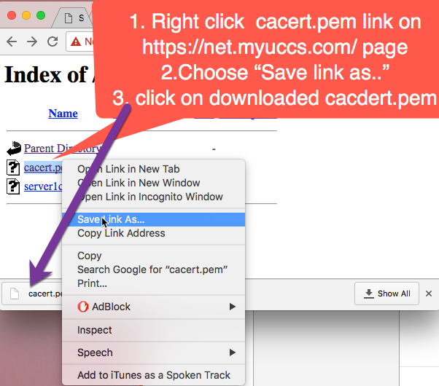
Install CA.myuccs.com
Notes:
Our CA certificate can be retrieved at https://net.myuccs.com/cert/ and save the cacert.pem using “save link as” Then open it to import to my mac’s security storage. You will be asked to enter the local admin password to allow put the new CA certificate there in the key chain.

Slide 7
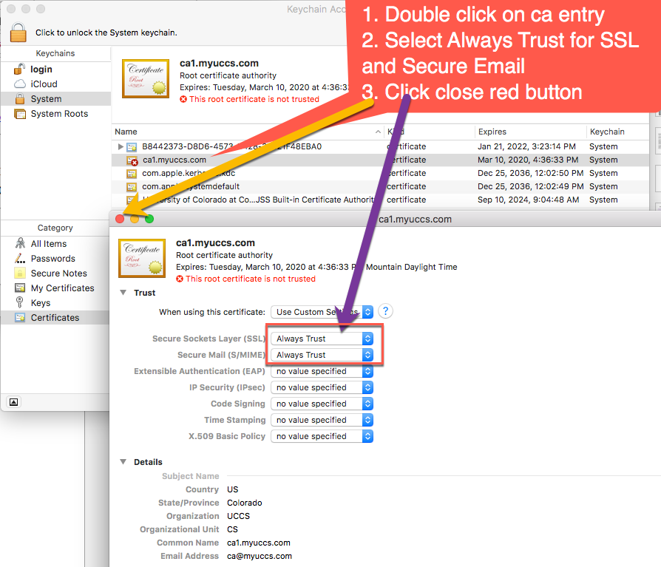
Trust CA.myuccs.com
Notes:
Afte it was insert into the key chain. It will still show a red cross sign. To change it to trust setting, we double click on the related ca entry in the keychain.
Change the SSL and Secure Email choices from ”no value specified” to “Always Trust”
Hit the upper left red button to activate the new settings.
You will be asked with the password for updating the settings in the key chain
The entry now with blue + sign instead of red cross sign.

Slide 8
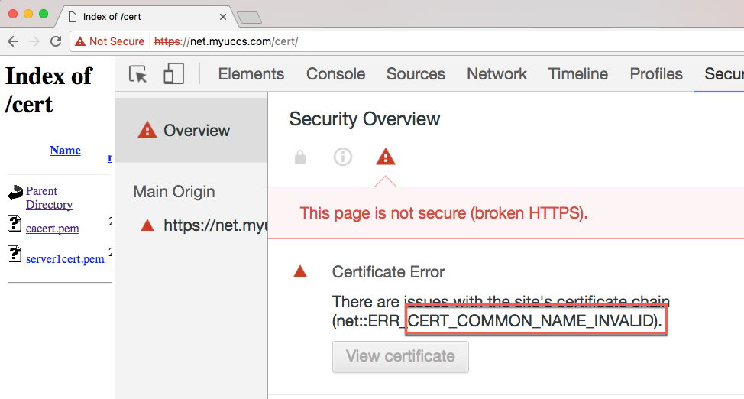

Revisit the Site Again. Still Have Problem!
It shows “CERT_COMMON_NAME_INVALID”! This is due to cs591.myuccs.com in certificate commonName field not match with domain name net.myuccs.com in the url user entered
Notes:
Let us refresh the chrome browser again. It shows still red not secure. Kind of disappointed. However the error message is new. It says Common Name invalid.
The reason is that the commonName in server certificate is cs591.myuccs.com, which different from the domain name of the url user entered. Net.myuccs.com. To fix that we need to regenerate the server certificate and use either net.myuccs.com as commonName or use *.myuccs.com

Slide 9
Create new Server Certificate and Private Key with *.myucc.com as commonName
[ec2-user@ip-172-30-0-148 server]$ /etc/pki/tls/misc/CA –newreq ….
Common Name (eg, your name or your server's hostname) []:*.myuccs.com
[ec2-user@ip-172-30-0-148 server]$ cp newreq.pem server2req.pem
[ec2-user@ip-172-30-0-148 server]$ cp newkey.pem server2key.pem <send server2req.pem for CA to sign it.>
[ec2-user@ip-172-30-0-148 tls]$ sudo cp server2cert.pem /etc/pki/tls/certs/localhost.crt
[ec2-user@ip-172-30-0-148 tls]$ cd /home/ec2-user/server
[ec2-user@ip-172-30-0-148 server]$ sudo openssl rsa -in server2key.pem -out server2.key
Enter pass phrase for server1key.pem: <enter passphrase>
writing RSA key
[ec2-user@ip-172-30-0-148 server]$ sudo chmod 700 *.key
[ec2-user@ip-172-30-0-148 server]$ sudo cp server2.key /etc/pki/tls/private/localhost.key
cp: overwrite ‘/etc/pki/tls/private/localhost.key’? y
[ec2-user@ip-172-30-0-148 server]$ sudo service httpd restart
Notes:
Here we repeat the server certificate and private key generation process with misc/CA –newreq command. The only change is that we change the common name value to *.myuccs.com and save the certificate request as server2req.pem. We then send the certificate for signing using misc/CA –sign. The resulting server2cert.pem is then replace the localhost.crt and the server2.keh replace the localhost.key. We then restart the httpd server.

Slide 10
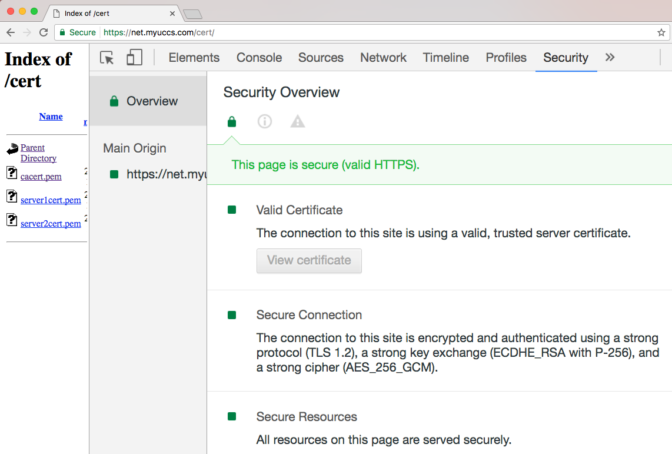
Finally it is Green and Secure!
We then reload the https://net.myuccs.com/cert/ web page.
Notes:
We then reload the https://net.myuccs.com/cert/ web page. Whala! Finally it is Green and Secure!

Slide 11
CS 5910
Fundamentals of Computer/Network Security
Lesson 16 Setup Client Certificate
Edward Chow, Ph.D.
University of Colorado, Colorado Springs
Notes:
In this lesson, we show how to create/sign client certificate request for web mutual authentication and secure email. The steps for combining the private key and signed certificate, and that for importing the combined p12 file into secure storage will also be presented

Slide 12
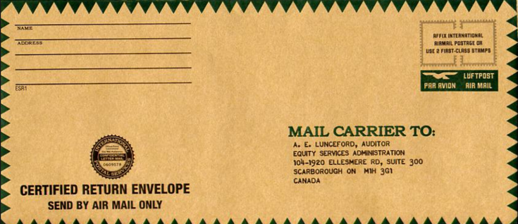

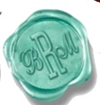

Web Mutual Authentication
1. https://net.myuccs.ed/secure/topsec.docx
3. Client present Client Certificate
/CN=EdwardChow/email=cchow@uccs.edu
Web Server
User/Browser
/CN=*myuccs..com/email=webmaster
2. Server present Server Certificate and request client to present client certificate
4. Top security document delivered
Notes:
Web client server mutual authentication follows the following four basic steps:
1. The user submits a https request with special url. Portion of the uri such as /secure here may trigger the web server to consider the request requires user to present additional client credential (certificate). This requirements may be specified in web server configuration file. 2. The web server then returns the http response with its server certificate and in its meta header triggers web browser to prompt the user to select specific client certificates in its key chain. 3. If there are multiple client certificates, the user can choose the one suggested by the “realm” name in the prompt or in the meta header. 4. The web server compares the subject name field of the client certificate against a list of allowed users, then decide to provide secure documents. Sometime the web server can present additional pre-agree-upon picture selected by the user during the account creation time so that the user can be sure that it is an authentic server. Besides the client certificate, the account can be configured to send one time passcode to user’s smart phone or email and ask users to enter as additional authentication step. This is also called multi-factor authentication.

Slide 13
Client Certificate Generation
[ec2-user@ip-172-30-0-148 ~]$ mkdir client; cd clint
[ec2-user@ip-172-30-0-148 client]$ /etc/pki/tls/misc/CA -newreq
Generating a 2048 bit RSA private key
…
writing new private key to 'newkey.pem'
Enter PEM pass phrase: <enter password>
Verifying - Enter PEM pass phrase: <confirm password>
-----
Country Name (2 letter code) [US]: enter
State or Province Name (full name) [Colorado]: enter
Locality Name (eg, city) [Colorado Springs]: enter
Organization Name (eg, company) [UCCS]: enter
Organizational Unit Name (eg, section) [CS]: enter
Common Name (eg, your name or your server's hostname) []: Edward Chow <your full name>
Email Address []: cchow@uccs.edu
…
A challenge password []: enter
An optional company name []: enter
Request is in newreq.pem, private key is in newkey.pem
[ec2-user@ip-172-30-0-148 server]$ cp newreq.pem chowReq.pem
[ec2-user@ip-172-30-0-148 server]$ cp newkey.pem chowKey.pem
Put in your full name. Here it is not as critical as server certificate. For server certificate the commonName need to match of the server domain name.
Use exact email address you set up on mail client
Send newreq.pem out to CA for signing
Keep this in protected directory. Don’t sent this to CA!!
Notes:
To create client certificate for client authentication. First Create a client directory; cd to the directory
Run /etc/pki/tls/misc/CA script with –newreq option It generates the private, public key pair. The script will ask for the subject name field.
We can hit enter for default or enter related info of your own site
For Common name use your full name. For email address field, make sure to use the exact email address of your mail account which set up on your mail client.
We rename newreq.pem as chowReq.pem or use yourloginameReq.pem and send it to CA for signing. We also save newkey.pem as chowKey.pem in a protected directory. Make sure do not send the key to CA!!

Slide 14
CA Sign Client Certificate and Export Clientg Key+Sigend Certificate
At CA side: [ec2-user@ip-172-30-0-148 ~]$ cd /etc/pki/tls
[ec2-user@ip-172-30-0-148 tls]$ sudo misc/CA –sign
[ec2-user@ip-172-30-0-148 tls]$ sudo cp newcert.pem chowCert.pem; sudo cp chowCert.pem /var/www/html/cert
[ec2-user@ip-172-30-0-148 tls]$ sudo cp chowCert.pem ~/client; cd ~/client At Client Side
[ec2-user@ip-172-30-0-148 client]$ openssl pkcs12 -export -in chowCert.pem -inkey chowKey.pem -out chowClient.p12
Enter pass phrase for chowKey.pem: <passphase of your private key>
Enter Export Password: <passphrase to protect your .p12 file>
Verifying - Enter Export Password: <passphrase to protect your .p12 file>
[ec2-user@ip-172-30-0-148 client]$ sudo cp chowClient.p12 /var/www/html/cert
Now we can download the chowClient.p12 file from web server and import you local client to setup the browser
Notes:
Here we show how CA signs the client certificate request. It is similar to that for signing the server certificate. After that we save it to web directory and the client directory (mimic the return of signed certificate).
On the client side, we use openssl pkcs12 command to combine the private key and signed certificate into a single file with p12 file format. The export passphrase is to protect the .p12 file in transit from the vm instance to our local machine. We will import it into any local client’s security storage for signing emails or client authentication

Slide 15
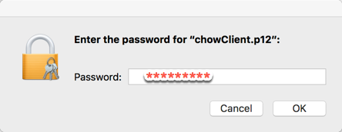
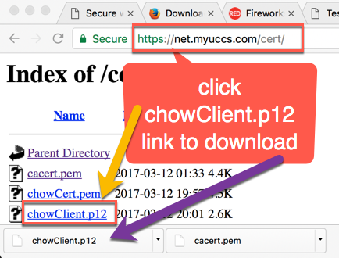
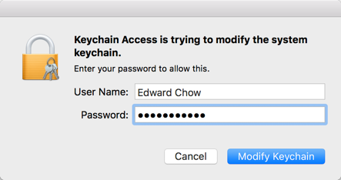
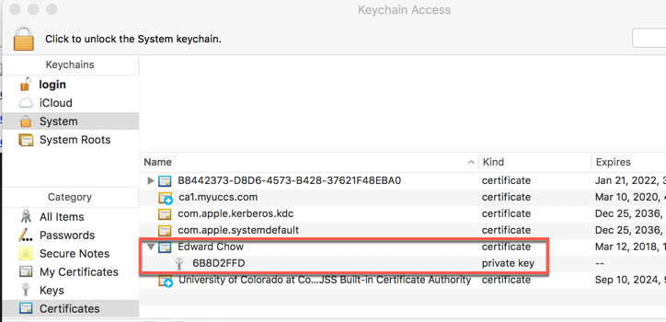
Import Client .p12 file into Local Secure Store
Open the .p12 file
Import to Key Chain
Notes:
Here we show on Mac how to import the client p12 file, we visit the web server cert directory. https://net.myuccs.com/cert/
Click the chowClient.p12 file there to download. Then open it. We will be asked to enter the protected passphrase of the p12 file.
We will also be asked to enter the local account password in order to save the private key and signed certificate into the key chain as shown here.
In the related exercise, we would like you to download the cs591Client.p12 and install it in the key chain also. These two .p12 files will be used to demonstrate the mutual authentication in the next lesson.
The MAC is now ready to do client authentication and secure email

Slide 16
CS 5910
Fundamentals of Computer/Network Security
Lesson 17 Mutual Authentication
Edward Chow, Ph.D.
University of Colorado, Colorado Springs
Notes:
In this lesson, we show how to setup web server and web client for mutual authentication.

Slide 17
Web Mutual Authentication
1. https://net.myuccs.ed/secure/topsec.html
3. Client presents Client Certificate
/CN=EdwardChow/email=cchow@uccs.edu
Web Server
User/Browser
/CN=*myuccs..com/email=webmaster
2. Server presents Server Certificate and request client to present client certificate
4. Top security document delivered
Notes:
Web client server mutual authentication follows the following four basic steps:
1. The user submits a https request with special url. Portion of the uri such as /secure here may trigger the web server to consider the request requires user to present additional client credential (certificate). This security requirement may be specified in web server configuration file. 2. The web server then returns the http response with its server certificate and in its meta header triggers web browser to prompt the user to select specific client certificates in its secure store. 3. If there are multiple client certificates, the user can choose the one suggested by the “realm” name in the prompt or in the meta header. 4. The web server compares the subject name field of the client certificate against a list of allowed users, then decide to provide secure documents or not. Sometime the web server can present additional pre-agree-upon picture selected by the user during the account creation time so that the user can be sure that it is an authentic server. Besides the client certificate, the account can be configured to send one time passcode to user’s smart phone or email and ask users to enter as additional authentication steps. It is also called multi-factor authentication.

Slide 18
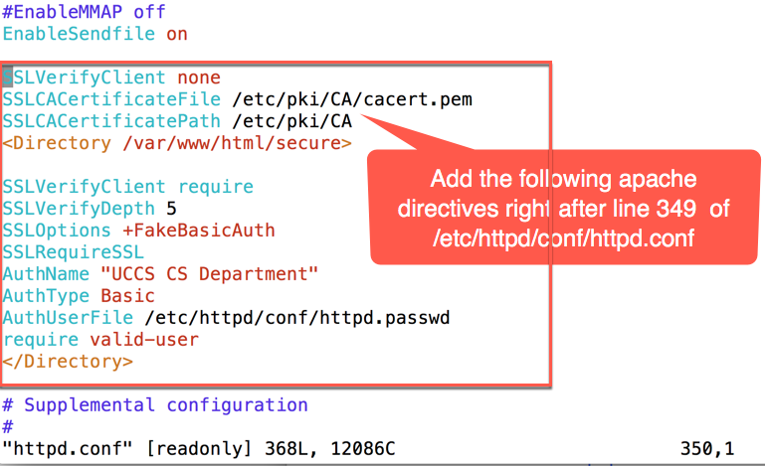
Set up Web Server Configuration for Mutual Authentication
Notes:
As a mutual authentication demo, we create a secure directory under /var/www/html default apache web server directory. We put a topsec.html file there with “for your eye only” as content for retrieval.
To protect this directory and require mutual authentication to access, we modify the /etc/httpd/conf/httpd.conf configuration file of httpd web servder. The SSLCAcertificate File indicate the actual locationof CA certificate where the web server can obtain the public key of CA used to sign those client certificate.
The first directive inside <Directory /var/www/html/secure> and </Directory> section indicate that
require SSLVerifyClient. The AuthName will show up on the prompt to remind the client which client certificate to use. The AuthUserFile points to the password file which lists all the subject name fields of clients that are allowed to access this secure directory. Note that not all the client certificates signed by the CA are allowed access. Only those with subject name field included in the password file are allowed access.

Slide 19
Httpd.passwd for Additional Client Limitation
[ec2-user@ip-172-30-0-148 conf]$ cd /etc/httpd/conf/httpd.conf; sudo vi httpd.passwd And add the following line:
/C=US/ST=Colorado/L=Colorado Springs/O=UCCS/OU=CS/CN=Edward Chow/emailAddress=cchow@uccs.edu:xxj31ZMTZzkVA
Here the first field before ’:’ is the exact subject name field content of chow’s certificate.
string " xxj31ZMTZzkVA" is used as the password in the user file and it is just the DES Crypt hash with Salt=XX of the word "password”.
You can verify this with https://unix4lyfe.org/crypt/
Notes:
To restrict further the users that can access the secure directory with a client certificate, we put the subject name field in a httpd.password file. The subfields are separated by / and name and value of the subfields are separated by =. The login and encrypted password is separated by ’:’. All entries in this file have the same encrypted password xxj31ZMTZzkVA since we verify the credential with signed client certificate, we really do not ask the user to enter password. The fakepassword is used to satisfy the web server password checking mechanism. The encrypted password is actually the word “password” apply to DES crypt hash with salt XX. You can try to verify this with any crypt online tool such as https://unix4lyfe.org/crypt/

Slide 20
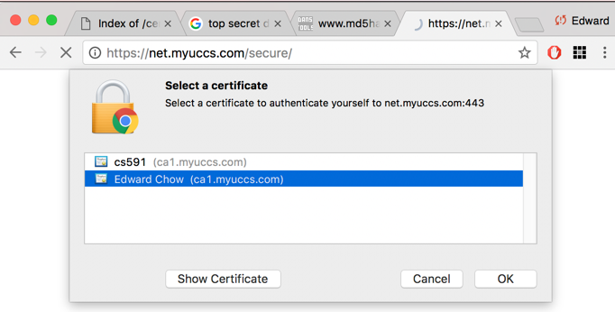
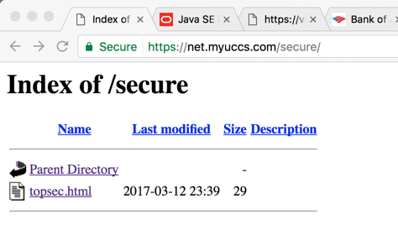
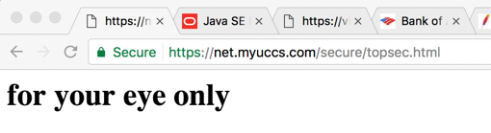
Access Secure Web Site with Mutual Authentication
Enter https://net.myuccs.com/secure/ Select Edward Chow certificate in the key chain
Notes:
First let us access the secure web site. The browser prompts us to select the two certificates in the key chain of mac. We choose Edward Chow certificate whose subject name field is in the httpd.password file of the web server.
We will be prompt by the local mac to enter the account password used to protect key chain. Then we are provided the directory content of the secure web site. By clicking the topsec.html link, we are asking again for accessing the client certificate in the key chain. Then the content of the topsec.html is delivered by web server and displayed by the browser.

Slide 21
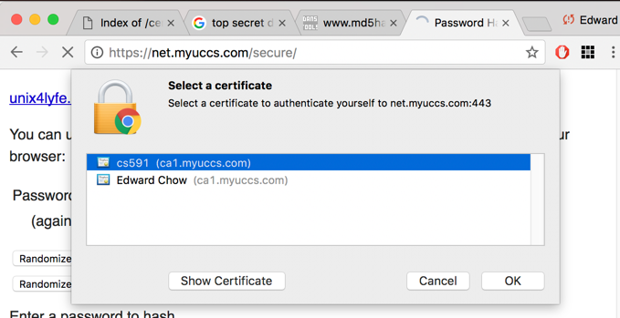
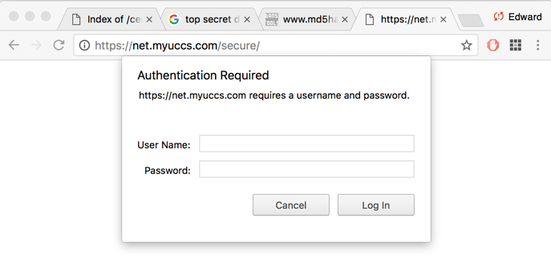
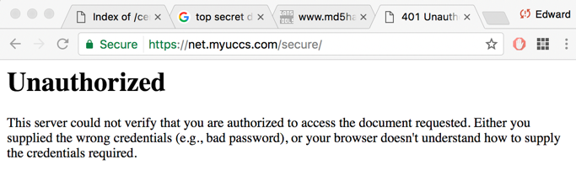
Access Secure Web Site with Mutual Authentication
Enter https://net.myuccs.com/secure/ Select cs591 certificate in the key chain
Unsuccessful access will lead to continuous prompt for user/password
Notes:
Next we try access the secure web site with the certificate signed by same CA but not in the httpd.passwd list . The browser prompts us to select the two certificates in the key chain of mac. We choose cs591 certificate whose subject name field is not in the httpd.passwd file of the web server.
We will prompt to enter the account password which is used to protect key chain. Then we are presenting with the login and password prompt. Actually at this point we are failed in accessing secure web site already. Enter any password will not access the secure directory. Hit cancel, you will get the ”Unauthorized” http response.
This concludes the presentation of mutual authentication.

